Slide 1
Building Inclusion through Digital Accessibility in Microsoft Word
Notes:
Grace

Slide 2
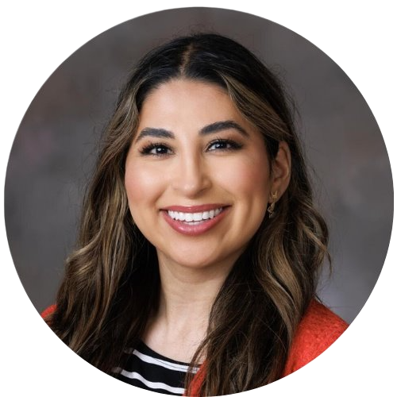
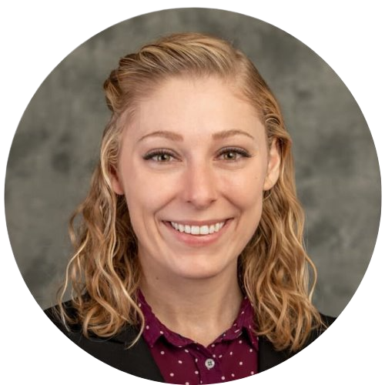
Today's Presenters
Clarisa Almazán
Instructional Designer, CTT
College of Business
Center for Transformative Teaching
Grace Troupe
Instructional Designer, CTT
Honors Program
Center for Transformative Teaching
Notes:
Clarisa

Slide 3
Objectives
Learn how to make a Word document accessible
Understand the "why" behind accessibility rules
Practice using the Accessibility Checklist
Notes:
Grace

Slide 4
Why make accessible documents?
It supports most of your students
Disabilities are common
Improves retention
Saves time in the long run
Inclusive environment
It's the law
Notes:
Clarisa – let them know they can look at this slide as it is a review from session 1
A common misconception is that accessibility is just for students with disabilities but it support most of your students.

Slide 5
Normalize not knowing yet
Grace's woeful accessibility as a teacher
Notes:
Grace, Academia hasn't had a structure for delivering this information to us in the past – so it is ok to not know yet and have questions!
Safe and open environment. Your time to ask questions. Instructional designers will be monitoring the chat, so feel free to put questions in as you have them – or say them out loud.

Slide 6
Remediating an existing Word document
Using the Word Accessibility Checklist
And this Sample Syllabus
Notes:
Grace
Distribute links for Checklist and syllabus.
Instruct on downloading syllabus and opening in the desktop version of Word.

Slide 7
Links Images Structure Tables Supplements
Let’s go over accessibility features that apply across all programs.
Notes:
Grace

Slide 8

L is for Links. Use descriptive links.
Raw links are not accessible: Use the accessibility checklist at this link: https://teaching.unl.edu/resources/accessibility-and-universal-design-learning/checklist/
Descriptive link are accessible: Use an Accessibility checklist to see if a document is accessible.
Notes:
Clarisa, Hyperlinked, embedded in the text, and explains what you are linking to

Slide 9
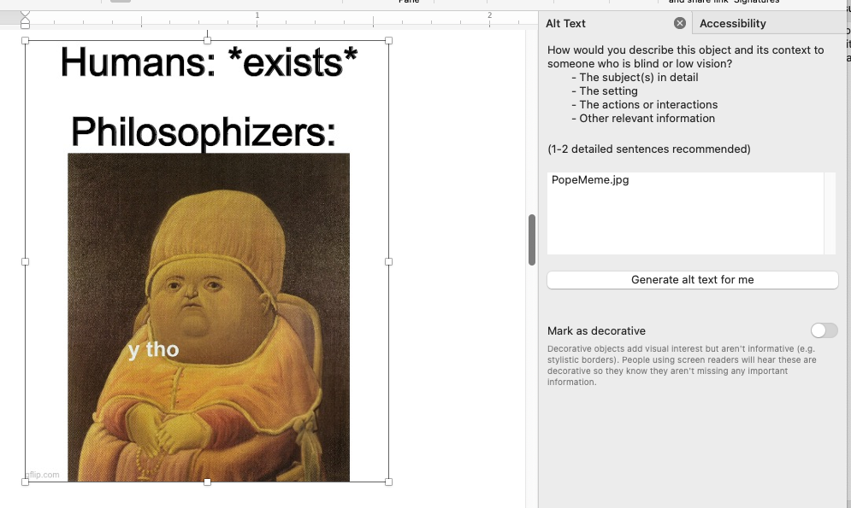
I is for images. Add alt text to your images.
Notes:
Clarisa: Alt text stands for alternative text. Alt text is a description of the image, including the specific context/meaning why it is there. This provides an alternative for our learners using screen readers who can’t see the image. It also is helpful when an image gets broken or won’t load because it will display the description from the alt text instead of just the file name.
Document: A meme featuring an edited painting of Pope Innocent X by Diego Velázquez, distorted to have a round face. The image includes text at the top: "Humans: exists" and "Philosophizers:". The painting features a caption over it that reads, "y tho," humorously implying that philosophers question human existence itself.

Slide 10
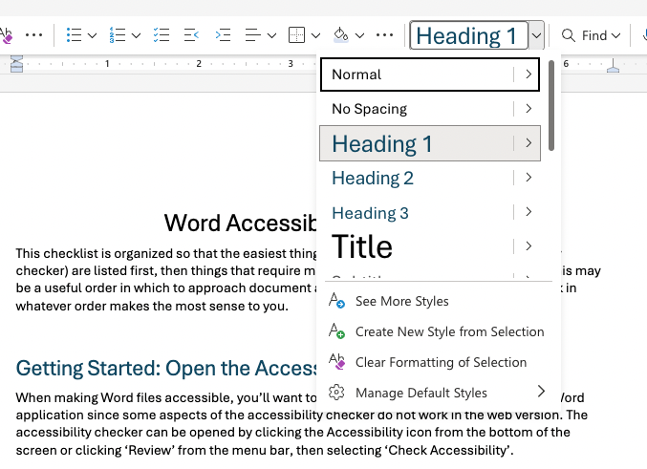
S is for structure. Use styles to add structure to your document.
Notes:
Grace

Slide 11
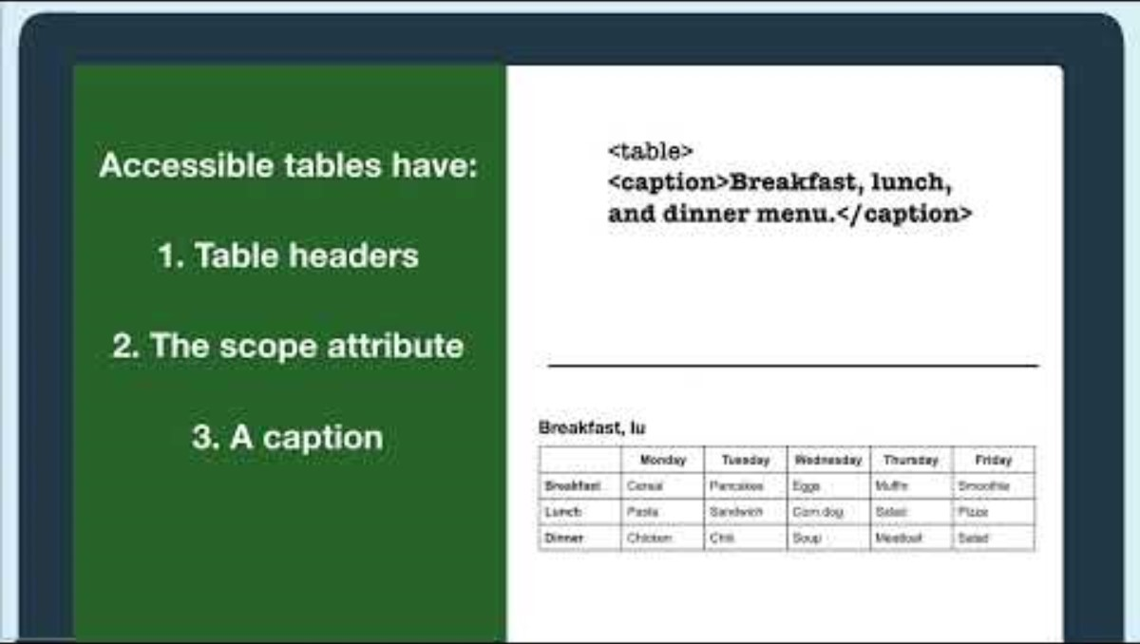
T is for tables. Tag your tables and only use tables for data.
Notes:
Grace

Slide 12
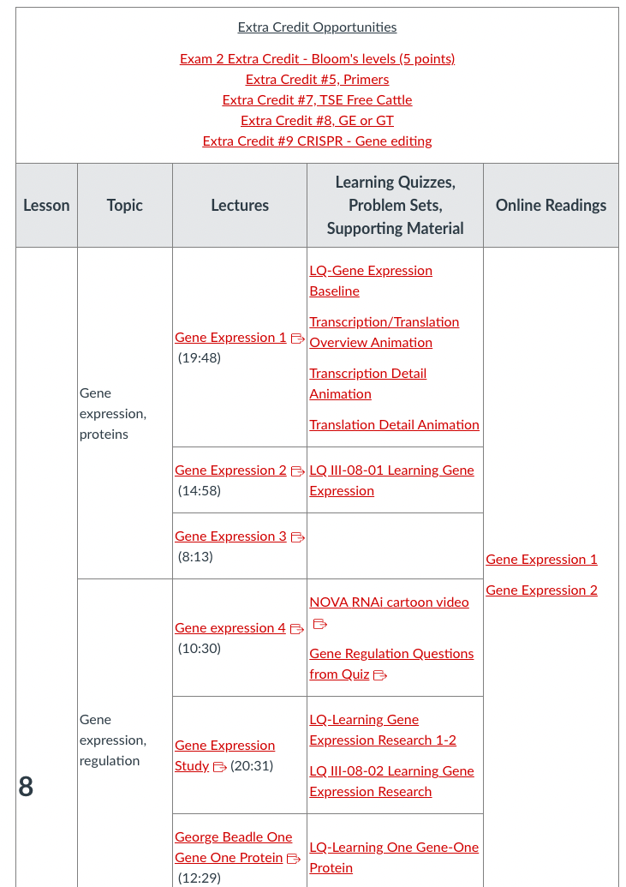
Don’t use tables to arrange content visually.
Notes:
Grace

Slide 13
Ready to dive in? Here are some next steps:
Learn the accessibility basics in each Microsoft program in under two hours with the Bridge Online Digital Accessibility Training
Use the Digital Accessibility Checklists to review your content
Talk with your instructional designer to make a plan
Notes:
Grace

Slide 14
Bring your own Word documents to next week’s working session
Notes:
Clarisa

Slide 15
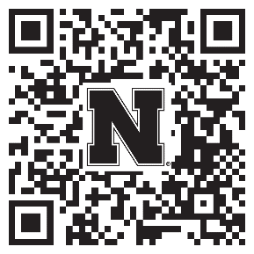
Help Strengthen Student Success At UNL!
Participate in a research study examining:
The accessibility of digital course materials in Canvas
How they impact students
Anyone teaching a credit-bearing course at UNL can participate
Conducted by the Center for Transformative Teaching (CTT)
To sign up: go.unl.edu/coursedesignstudy
Unsure? Questions? Contact amitchell22@unl.edu or aort@unl.edu
Notes:
Clarisa- CTT script
Because of your interest in promoting your students’ success, I wanted to invite you to participate in a research study examining the accessibility of digital course materials in Canvas and how they impact students. Anyone who teaches a credit-bearing course at UNL is eligible to participate. Participation can take 5 minutes to an hour, depending on your level of participation. The go link, QR code, and contact information for the lead investigators are on the screen if you would like to learn more or participate.

Slide 16
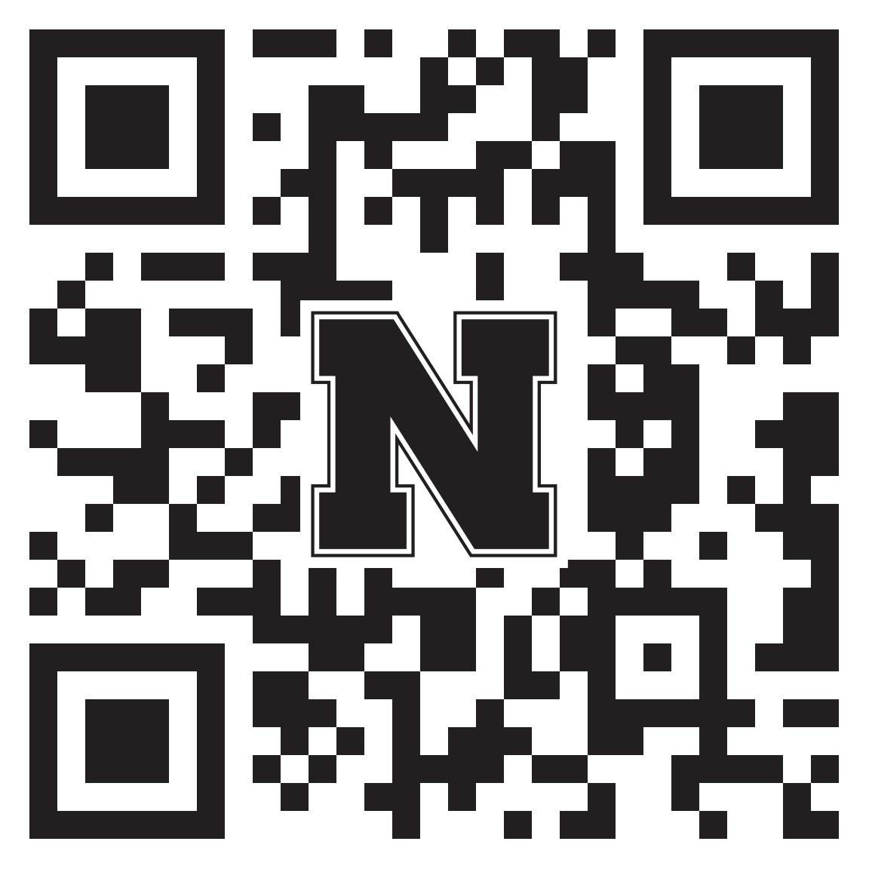
How did we do?
Your feedback is appreciated!
Please take a moment to fill out a short evaluation survey for this workshop:
https://go.unl.edu/fubn
Notes:
Clarisa

Slide 17
Building Inclusion through Digital Accessibility Microsoft Word Practice Session
Notes:
Grace

Slide 18
How will this session work?
We will open a breakout room for each participant
Open your own Word documents and use the Digital Accessibility Checklist for Commonly Used Programs to identify and remediate accessibility issues
Use the "Ask for Help" button for questions and an instructional designer will join your room
Notes:
Grace

Slide 19
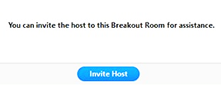
How do I get help?
Click Ask for Help in the meeting controls.
Confirm that you would like assistance by clicking Invite Host.
Notes:
Clarisa – let them know they can look at this slide as it is a review from session 1
A common misconception is that accessibility is just for students with disabilities but it support most of your students.

Slide 20
If you'd prefer to work in a collaborative room, stay in the main session for now
Notes:
Clarisa

